Slide 1


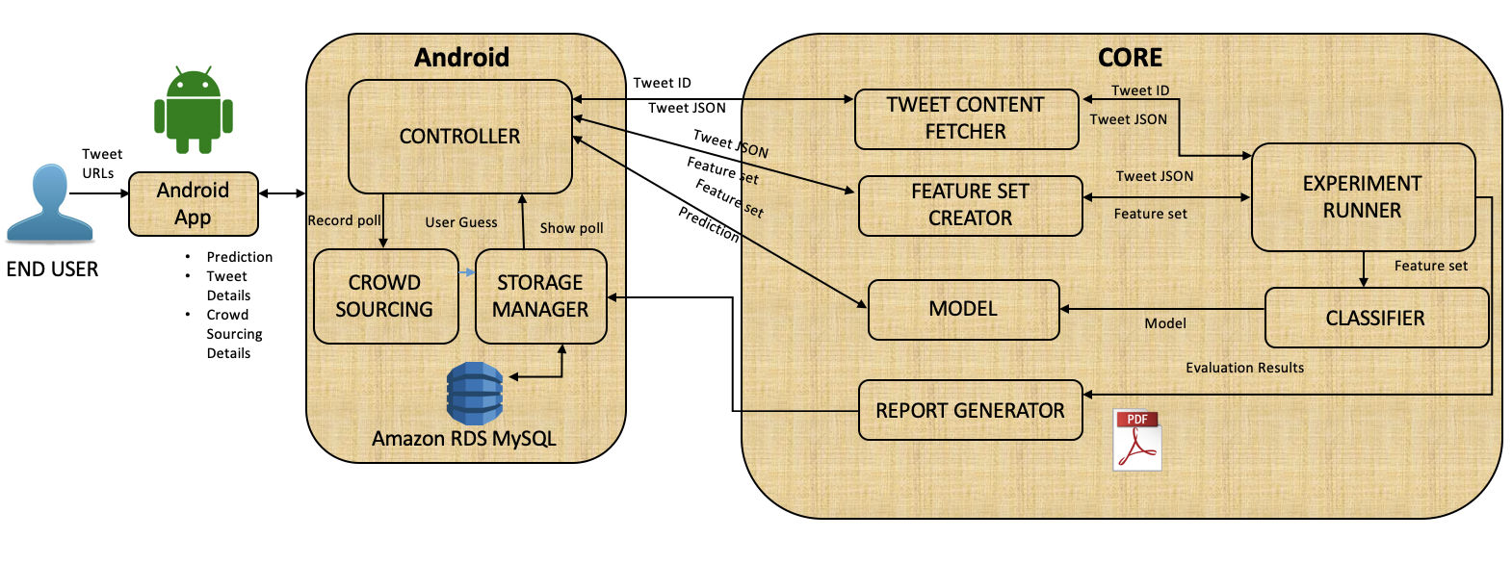
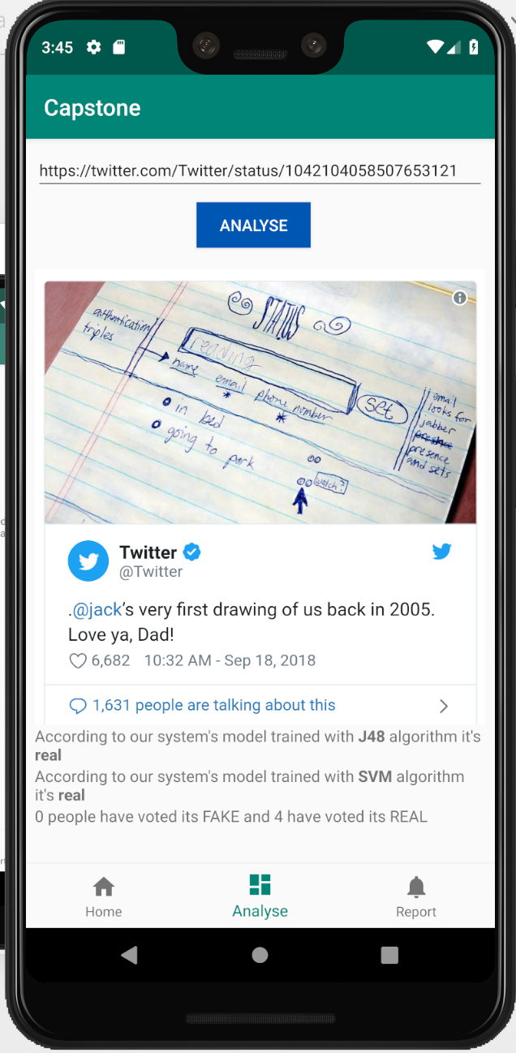
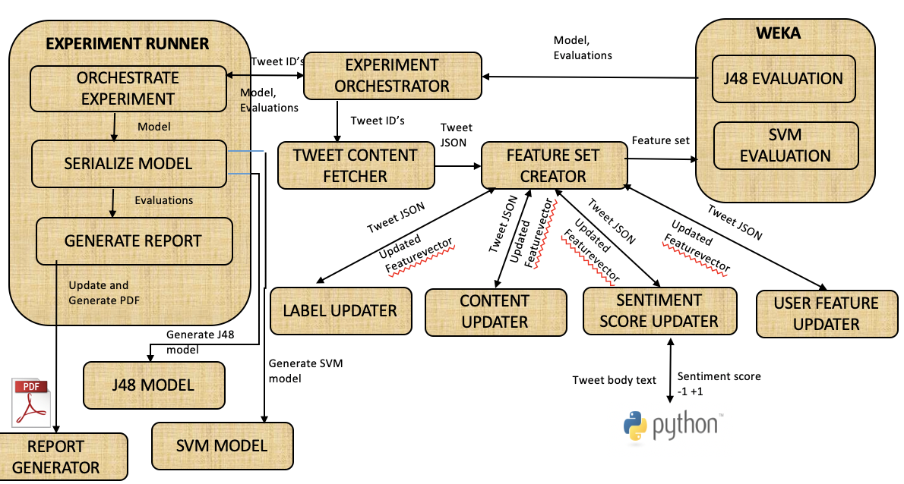




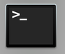
Fake Tweet Identifier Android Application Presenter: Tommy Tang Project Instructor: Dr. Min Chen
Project Overview
What I have done
What I Learned
Social media has significant influences on people’s everyday lives now. There are millions of tweets posted on Twitter per day, among which many of them are fake or incredible. These have negative impact on:
Broadcasting negative social contents
Distorting people’s decisions
Influencing companies’ products, reputations, etc.
How Android Application development works
Basic understanding of machine learning models
A full-stack alike development process and a product’s life cycle
The deployment architecture of a web-hosted product
How to think from the POV of System Design
Design
Users feed in twitter tweets URLs into the Android app (front-end)
Android app sends requests to controller through dispatch servlet to handle mapping
Core (back-end) retrieves requests and evaluates feature vectors, using different WEKA models
Results feed back to users
Users provide votes (crowd sourcing)
Objective
Present an Android App:
Analyzes tweets’ credibility based on
Machine Learning Models
Feature vectors
Google reverse image search
Python sentimental analysis
Allows users to provide votes (crowd sourcing)
Record data and generates/updates analysis report
Related Coursework
Android App (front-end)
User provides twitter URLs
Android app presents the analysis of credibility of tweets along with tweets’ contents and data analysis
Record users’ votes
CSS 342/343 – Core programming skills, and how to problem solve
CSS 360 – Agile software development
CSS 301 – Communication with technical and none technical individuals
CSS 370 – The design process
CSS 475 – Database design
Tools & Languages
Languages/ Frameworks: Android, Python, JavaScript, SQL, Java, Spring Boot
Tools: AWS EC2, AWS RDS, Android Studio, PyCharm, Forklift, Tomcat, Google API, Twitter API, SpringToolSuite 4, Terminal
Acknowledgements
Thanks to Saranya Krishnan, from whom I took over the project and who has developed the overall structure for backend and machine learning models
Additional thanks to Professor Min Chen for her guidance and advice.
Back-end
Experiment runner receives users input
Tweet Content Fetcher receives input and serializes models
Evaluation of tweets are fed back to the app, updating the datasets and report

